Slide 1
How To Build
Basic Desktop Applications
in Ruby
RubyConf 2024 Workshop (2h) • Thursday, November 14, 2023 11:15a-1:15p
Andy Maleh • Senior Software Engineer • Lexop • MS in Software Engineering • Fukuoka Ruby 2022 Special Award Winner • RailsConf/RubyConf Speaker
Notes:
Ask audience:
Who here knows what a Native GUI App is?
Why would you build a Native GUI App?
How many people have experience with Native GUI App development or desktop development in general?

Slide 2
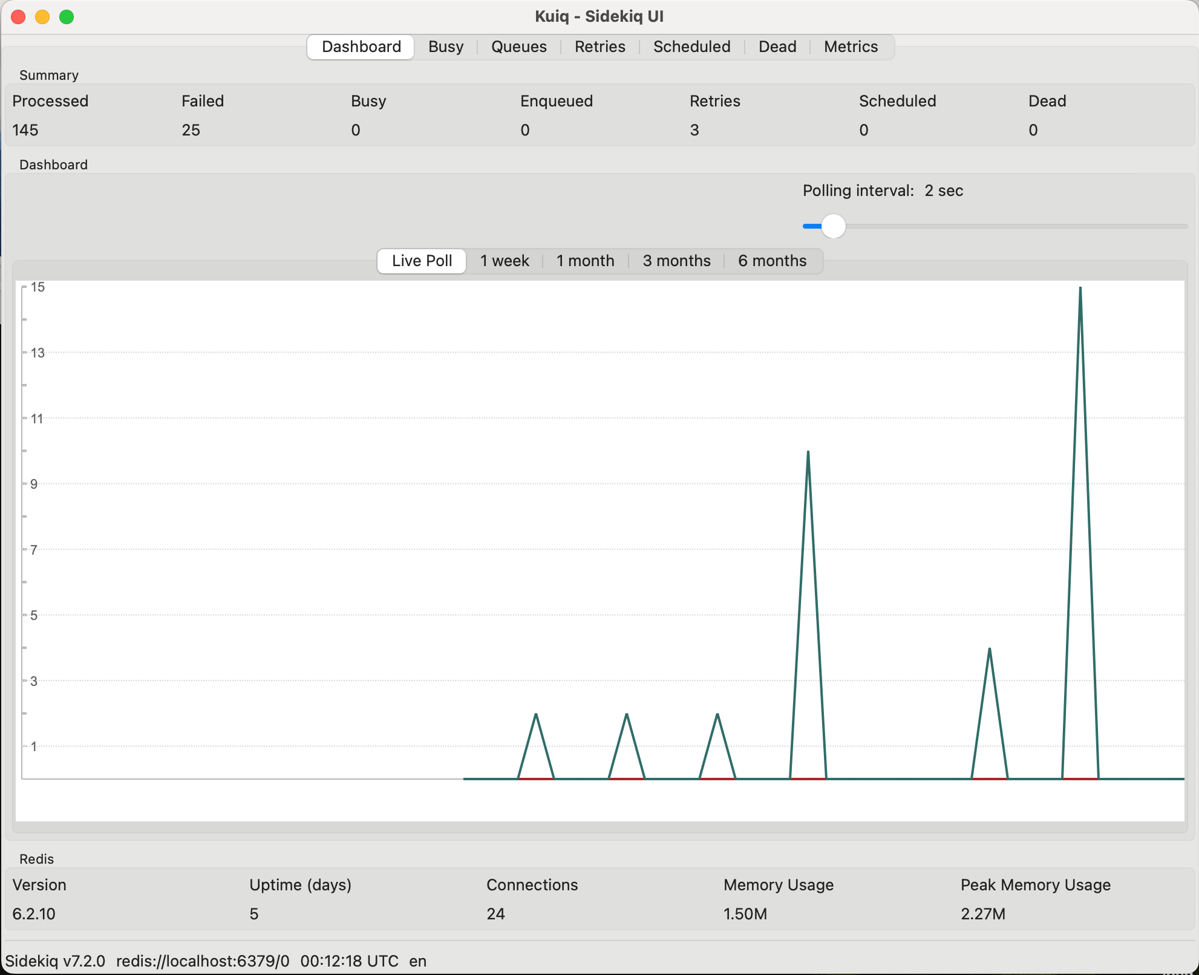
Kuiq
https://github.com/mperham/kuiq
Kuiq (UI for Sidekiq)
Open-source Ruby gem
Built by Mike Perham after attending this workshop in RubyConf 2023 (in collaboration with me).

Slide 3
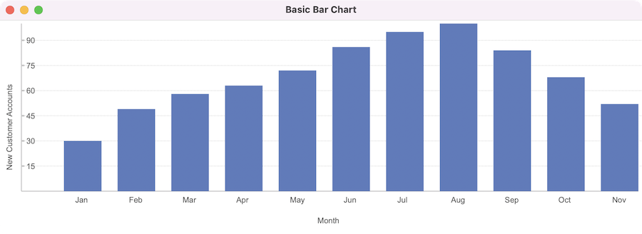
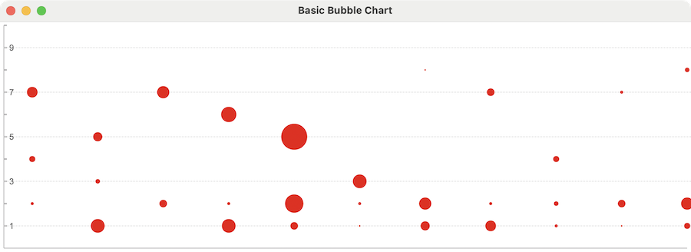
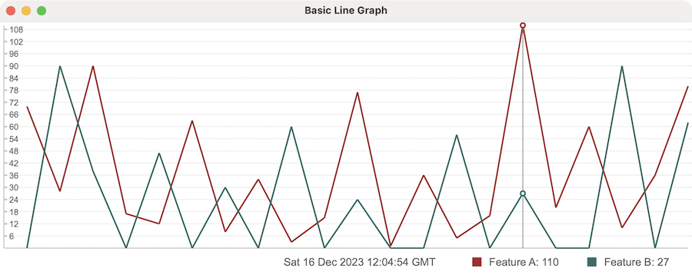
Glimmer DSL for LibUI Graphs and Charts
https://github.com/AndyObtiva/glimmer-libui-cc-graphs_and_charts
Open-Source Ruby gem extracted from Kuiq

Slide 4
Outline
GUI Basics
MVC Software Architecture
MVP & Data-Binding
Advanced Data-Binding
Custom Components (Bonus)
Scaffolding (Bonus)

Slide 5

https://github.com/AndyObtiva/how-to-build-desktop-applications-in-ruby
GitHub Repo for RubyConf 2024 Workshop: How To Build Desktop Applications in Ruby

Slide 6
Setup Workshop GitHub Repository
Before moving forward, please clone this GitHub repo (“⭐️” on GitHub):
git clone https://github.com/AndyObtiva/how-to-build-desktop-applications-in-ruby
Enter repo directory and run: bundle
This repo contains a link to presentation slides and code for all the exercises of the workshop, organized by section/exercise number.
The Resources section includes links for helpful references
Follow presentation slides at: bit.ly/rubyconf2024desktop

Slide 7
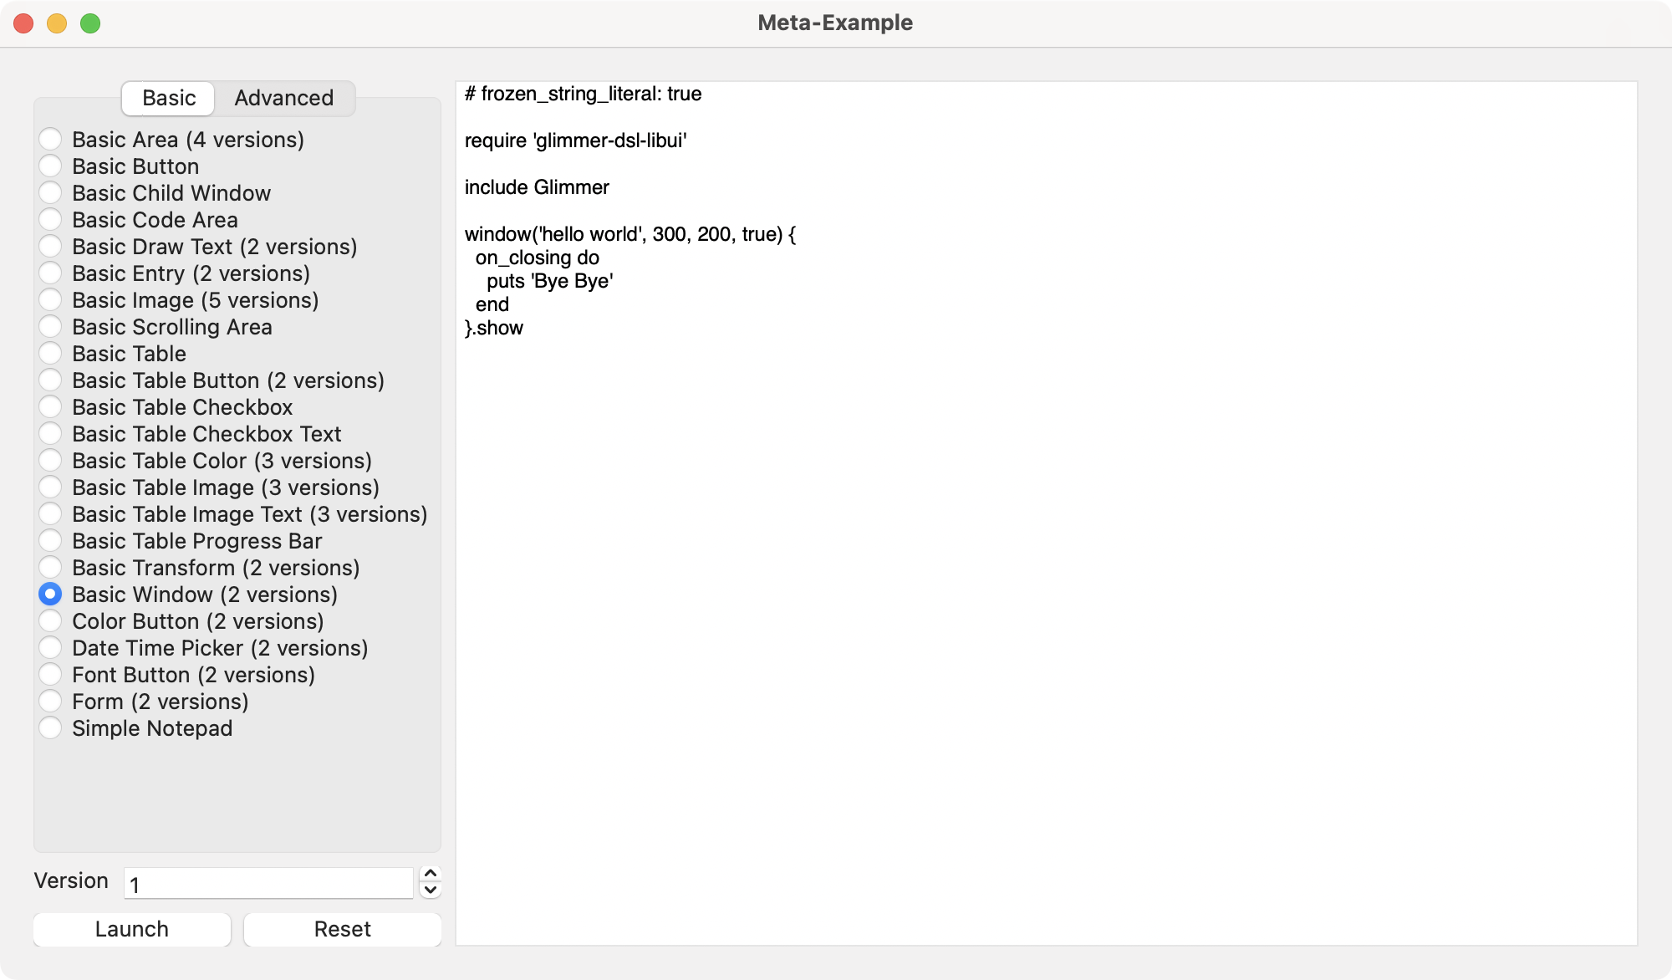
Setup Glimmer DSL for LibUI
Open Terminal/Command-Prompt/Git-Bash
Install this gem:
gem install glimmer-dsl-libui
Run this command to launch Glimmer Meta-Example:
glimmer examples

Slide 8
Intro GUI Examples

Slide 9
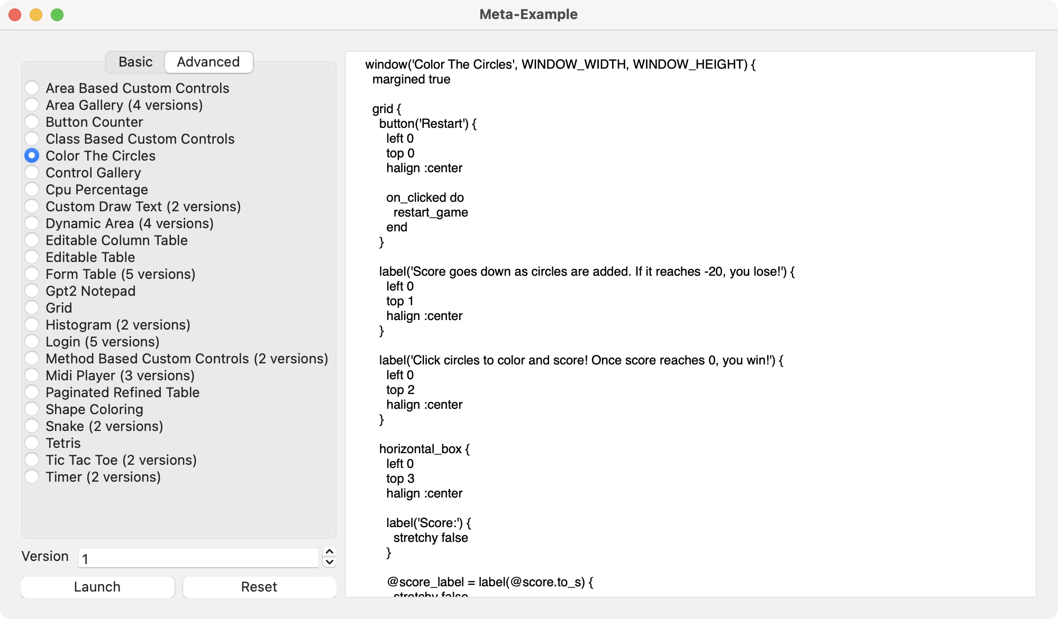
Intro GUI Examples

Slide 10
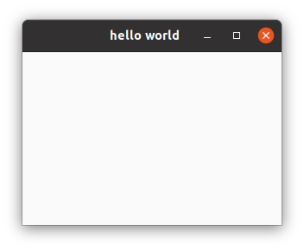
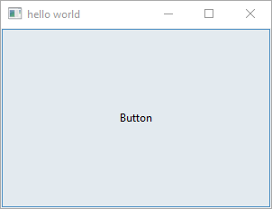
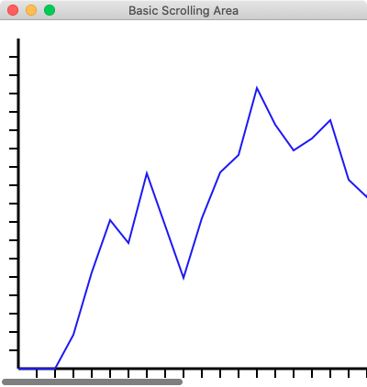
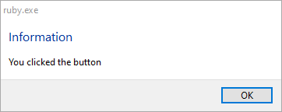
Basic Examples

Slide 11
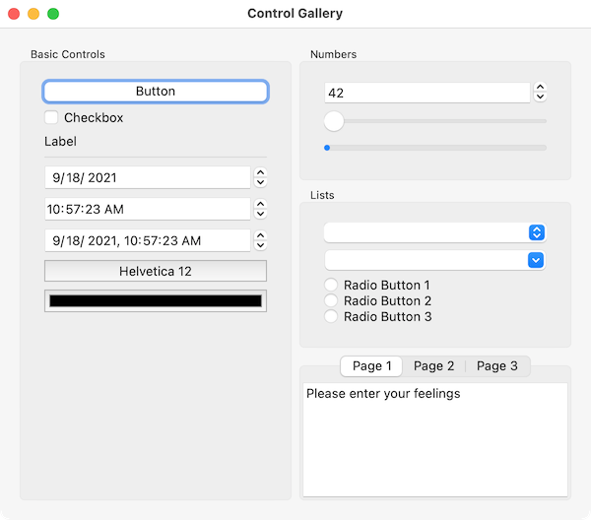
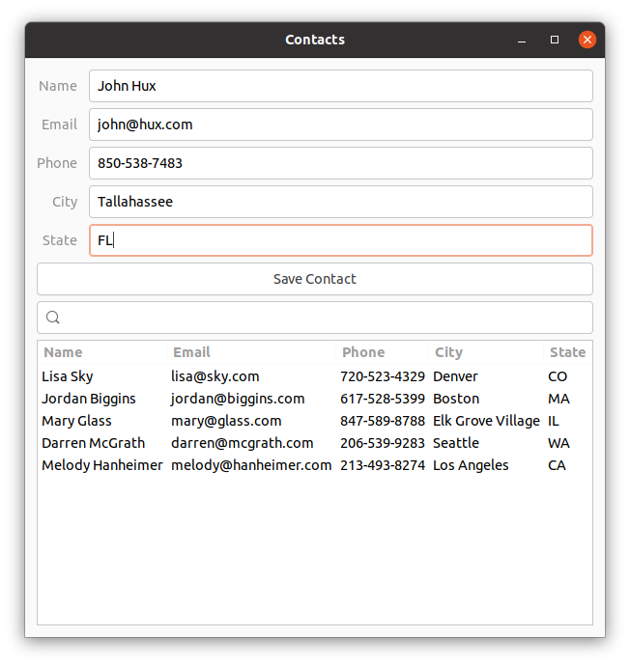
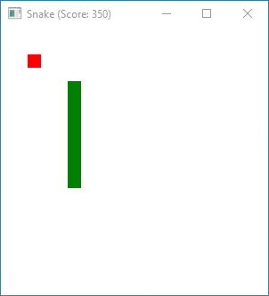
Advanced Examples

Slide 12
Section 1
GUI Basics

Slide 13
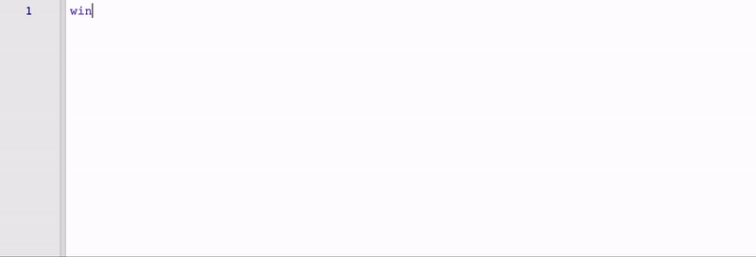
Introduction To Glimmer
Source: Glimmer DSL for SWT

Slide 14
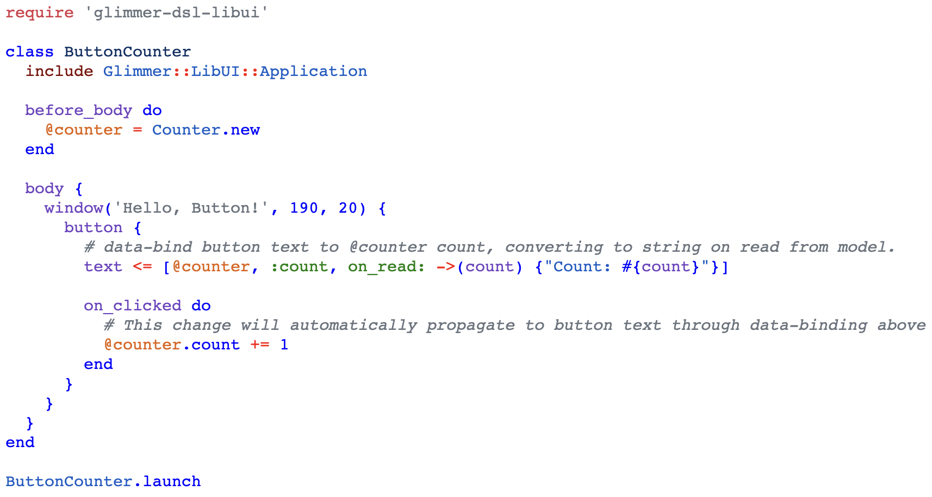
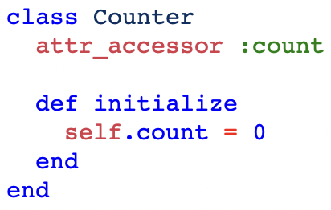
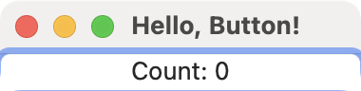
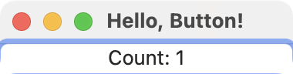

Button Counter Example

Slide 15
Glimmer DSL for LibUI Design Principles
The Ruby Way (including TIMTOWTDI: There Is More Than One Way To Do It)
Requiring the least amount of syntax possible to build GUI (Graphical User Interface)
Declarative syntax that visually maps to the GUI control hierarchy
Ability to mix declarative and imperative code conveniently without needing awkward & verbose technologies (e.g. no XML, HTML, ERB scriptlets, JSX)
Computers serve Software Engineers (not Software Engineers serve Computers)
Think only about real world concepts directly relevant to the GUI and interacting with it (no weird non-real-world irrelevant concepts like hooks/effects/immutability)
The Rails Way Convention over Configuration via smart defaults and automation of low-level details
Modular Software Design (e.g. support for Components)
No premature optimization

Slide 16
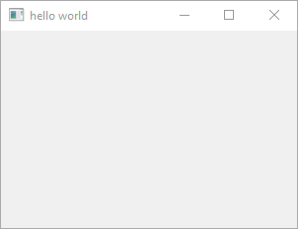

GUI DSL Basics
Glimmer GUI DSL enables building Graphical User Interfaces with a Ruby embedded (internal) Domain Specific Language
1) Control Keyword
Underscored case
Declarative control construction
Ruby method behind the scenes

Slide 17
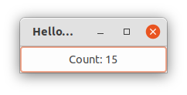

GUI DSL Basics
1) Control Keyword
Underscored case
Declarative control construction
Ruby method behind the scenes

Slide 18
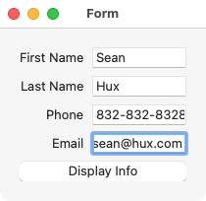

GUI DSL Basics
1) Control Keyword
Underscored case
Declarative control construction
Ruby method behind the scenes

Slide 19

GUI DSL Basics
1) Control Keyword
Underscored case
Declarative control construction
Ruby method behind the scenes

Slide 20
Controls
area
button
checkbox
code_area
combobox
color_button
date_time_picker
editable_combobox
entry
font_button
form
grid
group
horizontal_box
horizontal_separator
image
label
Full list at: Glimmer DSL for LibUI Supported Keywords

Slide 21
More Controls
menu
menu_item
message_box
multiline_entry
password_entry
progress_bar
radio_buttons
scrolling_area
slider
spinbox
tab
tab_item
table
time_picker
vertical_box
vertical_separator
window
Full list at: Glimmer DSL for LibUI Supported Keywords

Slide 22
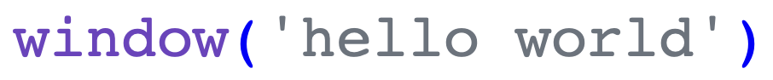
GUI DSL Basics
2) Control Arguments
Optional
Match LibUI C API

Slide 23
GUI DSL Basics
2) Control Arguments
Optional
Match LibUI C API

Slide 24
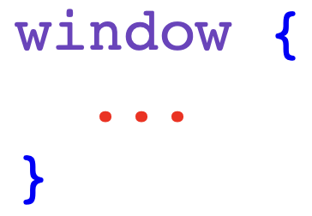
GUI DSL Basics
3) Control Content Block
Properties
Listeners
Nested Controls

Slide 25
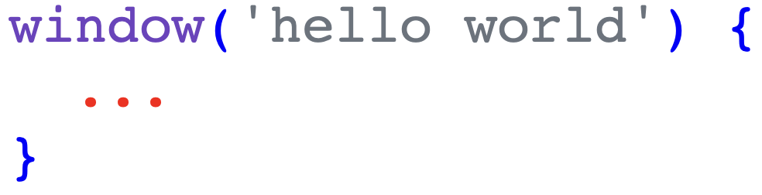
GUI DSL Basics
3) Control Content Block
Properties
Listeners
Nested Controls

Slide 26
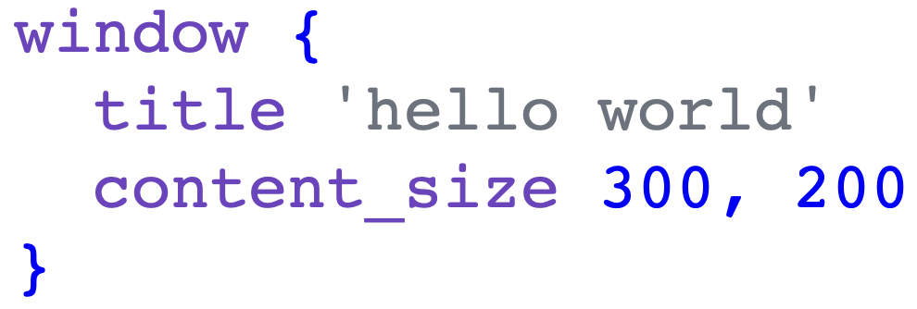
GUI DSL Basics
3a) Control Content Block - Properties

Slide 27
Control Properties
text
checked
editable
selected
color
time
margined
padded
value
items
read_only
title
width
height
Full list at: Glimmer DSL for LibUI Supported Keywords

Slide 28
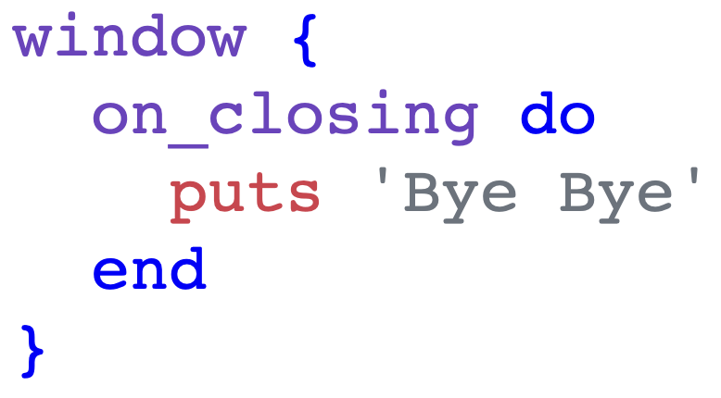
GUI DSL Basics
3b) Control Content Block - Listeners
Have `on_` prefix
Observer Pattern
Imperative code block

Slide 29
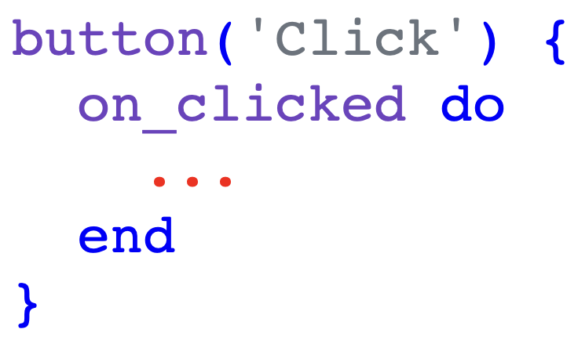
GUI DSL Basics
3b) Control Content Block - Listeners
Have `on_` prefix
Observer Pattern
Imperative code block

Slide 30
Control Listeners
on_clicked
on_changed
on_toggled
on_closing
on_content_size_changed
on_destroy
on_draw
on_selected
on_edited
on_mouse_down
on_mouse_up
on_mouse_drag_started
on_mouse_dragged
on_mouse_dropped
on_mouse_entered
on_mouse_exited
on_key_down
on_key_up
Full list at: Glimmer DSL for LibUI Supported Keywords

Slide 31
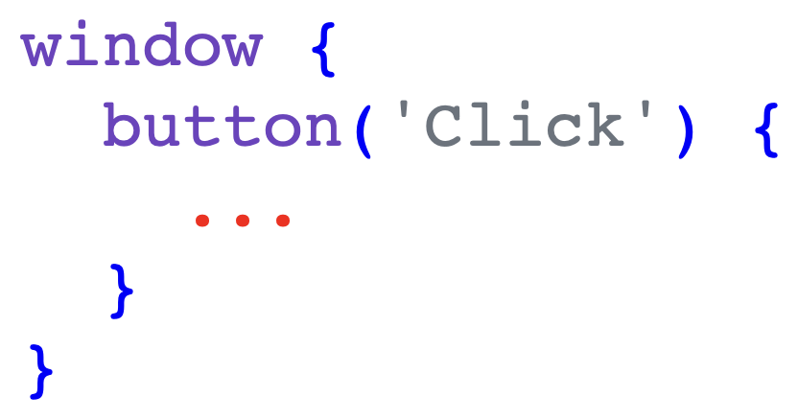
GUI DSL Basics
3c) Control Content Block - Nested Controls
Declarative Hierarchy
Composite Pattern

Slide 32
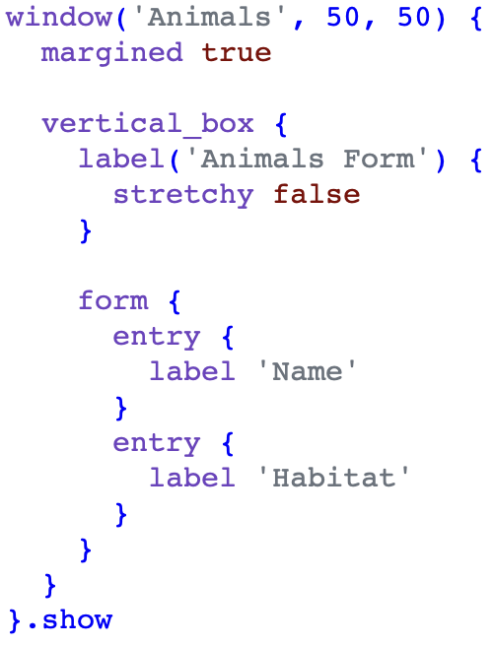
GUI DSL Basics
3d) Control Content Block - Layouts
Layout controls:
vertical_box
horizontal_box
form
grid (unstable)
Inside box layouts, stretchy prop decides taking all space or not
Inside form layout, label prop generates label for each control

Slide 33
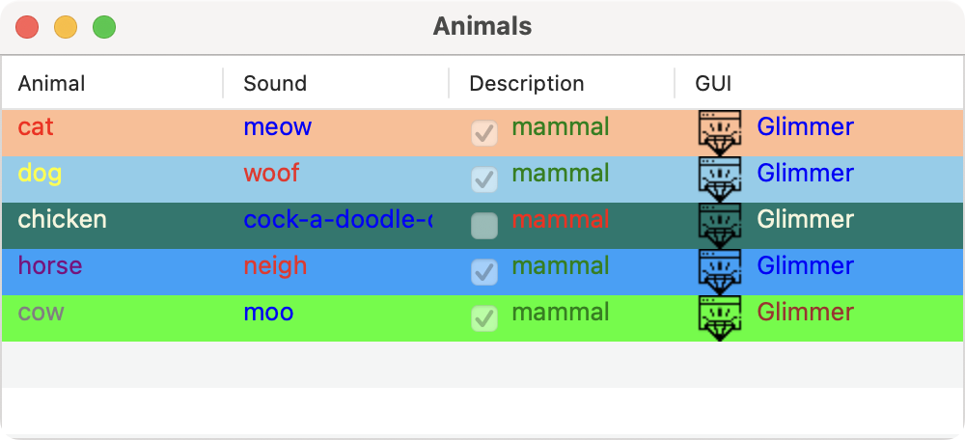
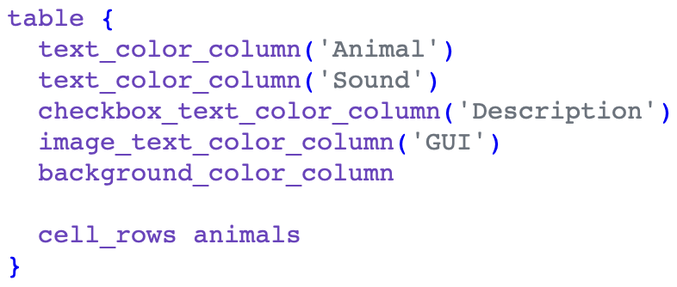
GUI DSL Basics
3e) Control Content Block - Table Columns
Columns can be nested under table:
background_color_column
checkbox_column
checkbox_text_column
checkbox_text_color_column
image_column
image_text_column
image_text_color_column
text_column
text_color_column
progress_bar_column

Slide 34
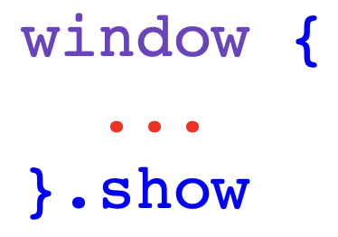
GUI DSL Basics
4) Control Operations
Invoked through Ruby Methods
Match LibUI C API
Proxy calls to wrapped LibUI objects
Include access to control properties after construction
Behavior is sometimes augmented with smart defaults
e.g. window.show starts GUI event loop

Slide 35
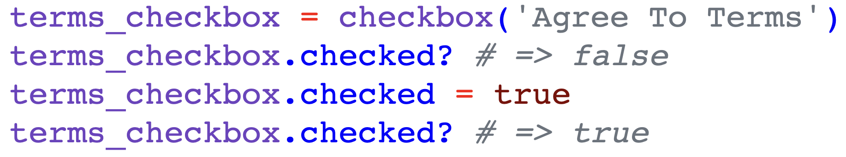
GUI DSL Basics
4) Control Operations (Ruby object methods)

Slide 36
Section 1
GUI Basics
Exercises

Slide 37
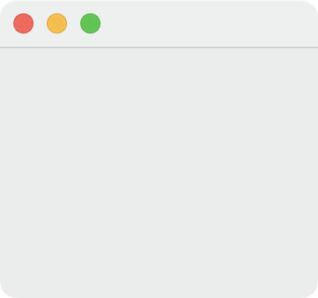

Exercise 1: Empty Window
Open Glimmer Meta-Example:
glimmer examples
Go to Basic Window example
Delete all code below include Glimmer
Add this code in place of old code and launch app:

Slide 38
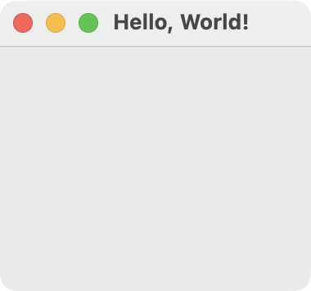
Exercise 2: Hello, World! Window w/ Args
Add this code in place of last code below include Glimmer and launch app:

Slide 39
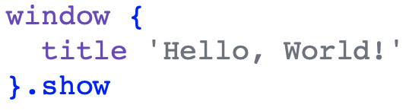
Exercise 3: Hello, World! Window w/ Props
Add this code in place of last code below include Glimmer and launch app:

Slide 40
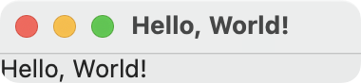
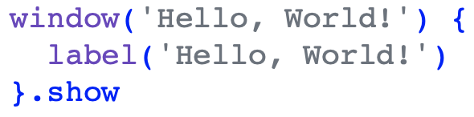
Exercise 4: Hello, World! Window + Label w/ Args
Add this code in place of last code and launch app:

Slide 41
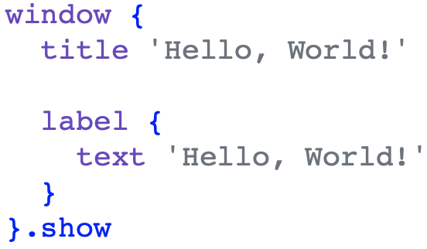
Exercise 5: Hello, World! Window + Label w/ Props
Add this code in place of last code and launch app:

Slide 42
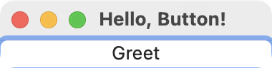
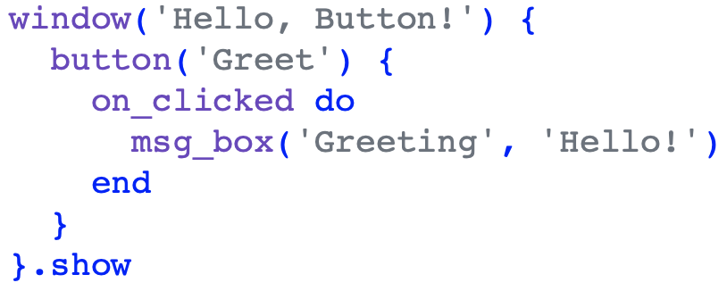
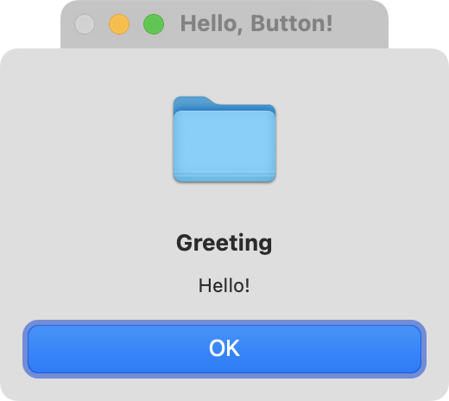
Exercise 6: Hello, Button!
Add this code in place of last code and launch app:

Slide 43
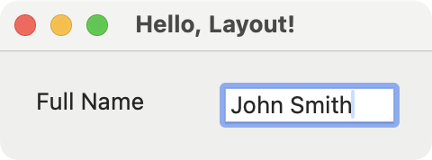
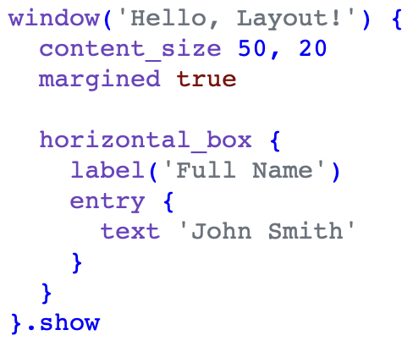
Exercise 7: Hello, Layout! w/ Horizontal Box
Add this code in place of last code and launch app:

Slide 44
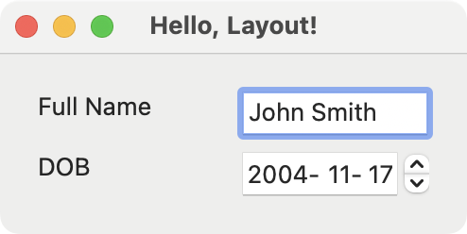
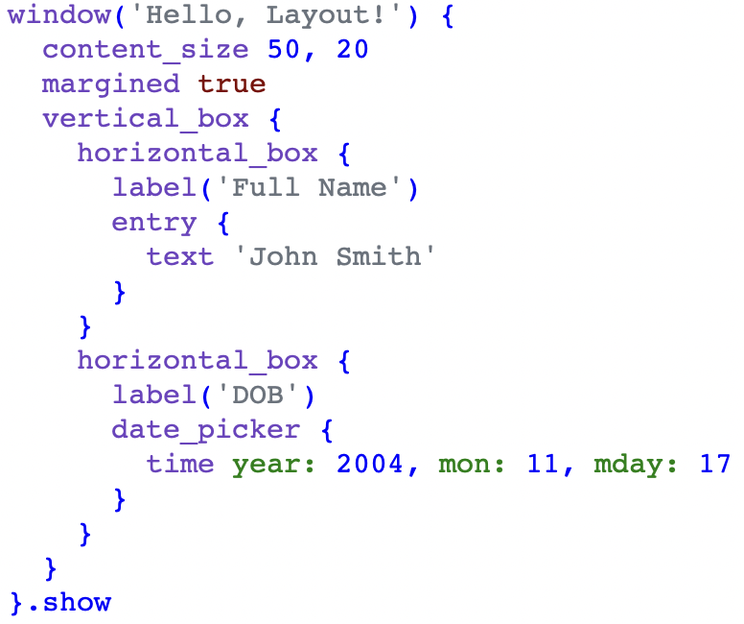
Exercise 8: Hello, Layout! w/ Horizontal & Vertical Boxes
Add this code in place of last code and launch app:

Slide 45
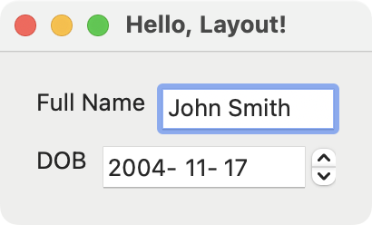
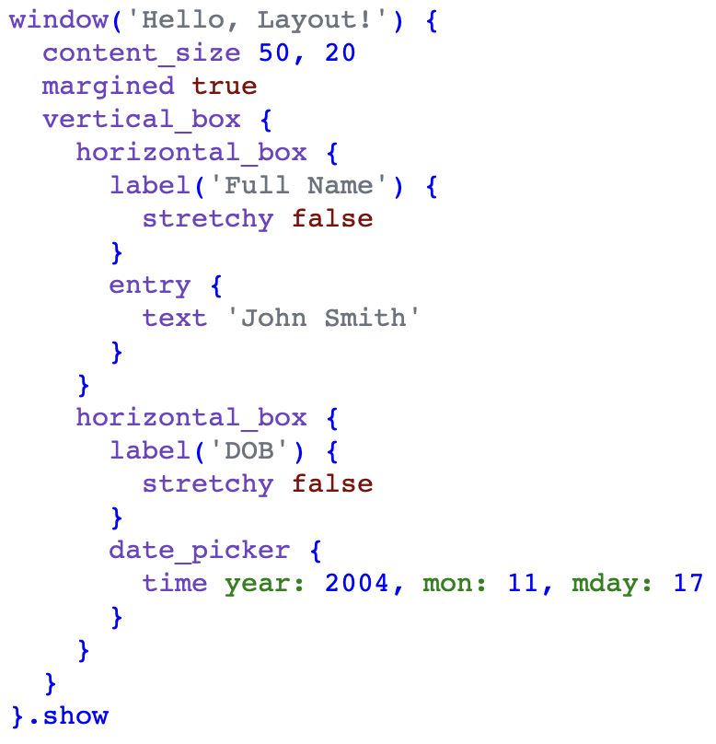
Exercise 9: Hello, Layout! w/ Box Stretchy
Add this code in place of last code and launch app:

Slide 46
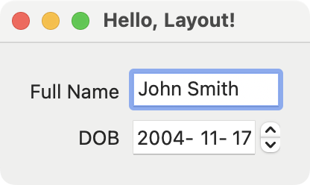
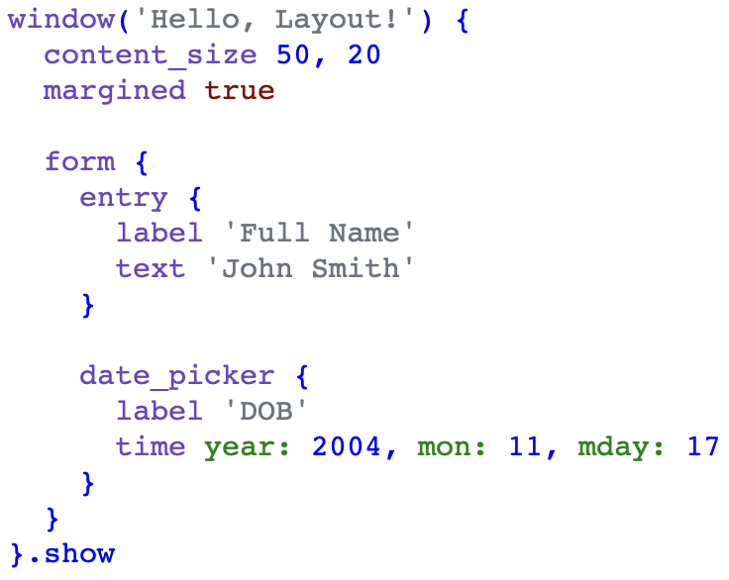
Exercise 10: Hello, Layout! Form
Add this code in place of last code and launch app:

Slide 47



Exercise 11: Option Selector

Slide 48


Section 1 Test
Implement an address form with the following fields:
Full Name (entry)
Street (entry)
City (entry)
State (entry)
Zip (entry)
Billing & Shipping (checkbox)

Slide 49
Section 1 Test 1
Add a summary label at the bottom that is updated when these listeners are triggered:
on_changed for entry fields
on_toggled for checkbox field
Address summary format examples:
Unchecked Billing & Shipping: "John Doe, 1 Park, Chicago, IL, 60654"
Checked Billing & Shipping: "John Doe, 1 Park, Chicago, IL, 60654 (Billing & Shipping)"

Slide 50
Section 2
MVC Software Architecture

Slide 51

MVC Software Architecture

Slide 52
Observer Pattern
Observer Design Pattern is foundational in MVC Architectural Pattern
In MVC (Model-View-Controller):
Controller observes View for user actions (e.g. mouse/keyboard) and trigger changes in Model
View observes Model for domain data changes and updates itself
In Glimmer GUI DSL (Graphical User Interface Domain Specific Language):
Controller can rely on Listeners to observe View actions and trigger changes in Model
View can rely on observe(model, attribute) method to observe a Model attribute for changes and update its controls accordingly. It relies on Ruby Meta-Programming to auto-enhance a Model into an ObservableModel

Slide 53
Glimmer::DataBinding::Observer
Behind the scenes, the observe keyword, which requires include Glimmer:
observe(model, attr) {
...
}
is equivalent to the following code WITHOUT include Glimmer, which is useful in Models that need to observe other Models without mixing the Glimmer DSL:
Glimmer::DataBinding::Observer.proc {
...
}.observe(model, attr)

Slide 54


MVC Example - Explicit Controller
View observed by Explicit Controller to indirectly toggle option in Model
Model observed by View to indirectly update View label text when Model changes

Slide 55

MVC Example - Implicit Controller
View observed by Implicit Controller (Listener) to directly toggle option in Model
Model observed by View to indirectly update View label text when Model changes

Slide 56
Section 2
MVC Software Architecture
Exercises
(Follow on GitHub)

Slide 57
Section 2 Test 1
Refactor address form app from Section 1 Test to follow MVC with implicit Controller:
Address class (Model): stores text/boolean attributes and computes summary
AddressFormView class (View): wires listeners to update Model attributes & observes Model attributes to update address summary

Slide 58
Section 3
MVP & Data-Binding

Slide 59

MVP & Data-Binding Software Architecture

Slide 60


Property Data-Binding
Property Data-Binding declaratively & automatically synchronizes View properties w/ Model attributes bidirectionally or unidirectionally
Bidirectional (two-way) with <=> for View read/write properties

Slide 61


Property Data-Binding
Unidirectional (one-way) with <= for View read-only properties

Slide 62


MVC+MVP Data-Binding Example

Slide 63

Table Data-Binding
table cell_rows can be data-bound to an array of models/hashes or Enumerator/Enumerator::Lazy for lazy-loading
Table data-binding automatically detects model attributes from column names by convention
Setting editable true enables editing table & bidirectional data-binding

Slide 64

Table Data-Binding
table cell_rows column mapping may still be customized manually if needed by passing in column_attributes option

Slide 65
Content Data-Binding
Content Data-Binding declaratively & automatically generates (re-renders) View content in response to Model attribute changes
Under a control, nest dynamically generated content inside an explicit content block that specifies the model and attribute to observe:
content(model, attribute) {
… # controls to generate dynamically
}

Slide 66



Content Data-Binding Example

Slide 67
Section 3
MVP & Data-Binding
Exercises
(Follow on GitHub)
Notes:
Specify what to do in exercises 13, 14, and 16

Slide 68
Section 3 Test 1
Refactor address form app from Section 2 Test to follow MVP with Data-Binding:
Address class (Model): stores text/boolean attributes and computes summary
AddressFormView class (View): data-binds fields to Model attributes using the computed_by option for data-binding the Model summary attribute

Slide 69

Section 3 Test 2
Movie Reviews App that stores movie reviews by reviewers and then calculates the average rating for each movie while listing movie ratings in a table.

Slide 70
Section 3 Test 2
Movie Reviews App that follow MVP with Table Data-Binding & Attribute Data-Binding:
MovieReview class (Model): stores/resets attributes (can be Struct):
[attribute] reviewer (String)
[attribute] movie (String)
[attribute] rating (Float)
MovieRating class (Model): stores attributes and formats rating (can be Struct):
[attribute] movie (String)
[attribute] average_rating (Float)
[attribute] reviewers (String): comma-separated list of reviewers
[method] rating formats average_rating as 2 decimal String

Slide 71
Section 3 Test 2
Movie Reviews App that follow MVP with Table Data-Binding & Attribute Data-Binding:
MovieReviewsPresenter class (Presenter): has the following methods:
[method] new_movie_review: object to data-bind MovieReview form in View
[method] movie_reviews: stores MovieReview Array
[method] movie_ratings: calculated from movie_reviews (average rating per movie)
require 'facets/array/average' to calculate movie average rating
[method] save: saves new movie review
MovieReviewsView class (View)
New movie review form and save button to save new movie reviews by reviewers:
reviewer entry
movie entry
rating spinbox(1, 10)
Movie rating table

Slide 72
Section 4
Advanced Data-Binding

Slide 73
Advanced Data-Binding
Data-Binding Converters
Data-Binding Hooks
Computed Data-Binding
Nested Data-Binding
Indexed Data-Binding
Keyed Data-Binding
Details at: Glimmer DSL for LibUI Data-Binding API

Slide 74

Data-Binding Converters
Data-Binding Converters enable:
Transforming Model attributes (on read) before displaying in View
Transforming View properties before storing in Model (on write)
on_read: -> (val) {...} : convert on read from Model to View
on_write: -> (val) {...} : convert on write to Model from View

Slide 75

Data-Binding Converter Example
Dynamic Form

Slide 76
Data-Binding Hooks
Data-Binding Hooks perform actions before and/or after copying data between View properties and Model attributes
before_read: -> (val) {...} : do work before reading data from Model to View and before on_read converter is called
after_read: -> (val) {...} : do work after reading data from Model to View and after on_read converter is called
before_write: -> (val) {...} : do work before writing data to Model from View and before on_write converter is called
after_write: -> (val) {...} : do work after writing data to Model from View and after on_write converter is called

Slide 77


Data-Binding Hook Examples

Slide 78

Computed Data-Binding
Computed Data-Binding enables observing extra Model attributes that are dependencies of a computed Model attribute so that when any of the extra attributes change, the View is updated from the computed attribute accordingly.
Examples:

Slide 79
Nested/Indexed/Keyed Data-Binding
Nested data-binding enables data-binding a View property to a nested Model attribute (e.g. user.address.street)
Indexed data-binding enables data-binding a View property to an indexed Model attribute within an Array attribute (e.g. user.names[0])
Keyed data-binding enables data-binding a View property to a keyed Model attribute inside a Hash attribute (e.g. user.names[:nickname])

Slide 80

Nested/Indexed/Keyed Data-Binding Examples

Slide 81
Section 5
Custom Components
(Bonus)

Slide 82



Custom Controls
Custom Controls
include Glimmer::LibUI::CustomControl
Accept options that can be passed as Hash arguments
Define body block with Glimmer GUI DSL
before_body block hook to setup variables
after_body block hook to register listeners
body_root API method returns root control
Useful for:
Specializing Controls
Aggregating Controls
Build brand new non-native controls with Area graphics

Slide 83


Custom Windows
Custom Windows (aka Applications)
include Glimmer::LibUI::CustomWindow
Or include Glimmer::LibUI::Application
Custom Windows are Custom Controls with window as body root
Represent apps or reusable custom windows
Automatic implementation of .launch method

Slide 84
Section 5
Custom Components
(Bonus)
Exercises
(Follow on GitHub)

Slide 85
Section 8
Scaffolding

Slide 86
Glimmer Scaffolding
glimmer command enables scaffolding apps, custom components (custom controls, custom windows, and custom shapes), and packaging gems:
glimmer scaffold[app_name]
glimmer scaffold:customcontrol[name,namespace]
glimmer scaffold:customshape[name,namespace]
glimmer scaffold:customwindow[name,namespace]
glimmer scaffold:gem:customcontrol[name,namespace]
glimmer scaffold:gem:customshape[name,namespace]
glimmer scaffold:gem:customwindow[name,namespace]

Slide 87
Application Scaffolding
Application scaffolding enables automatically generating the directories/files of a new desktop GUI application that follows the MVC architecture and can be packaged as a Ruby gem that includes an executable script for running the app conveniently.
Scaffolding ensures that Software Engineers follow the recommended Glimmer DSL for LibUI conventions and best practices.
Application Scaffolding greatly improves Software Engineering productivity when building desktop applications.

Slide 88
Application Scaffolding Instructions
Run: glimmer "scaffold[app_name]"
bin/app_name runs the scaffolded app (or glimmer run)
App namespace is app/app_name.rb
App entry point is app/app_name/launch.rb
Views live under app/app_name/view
Models live under app/app_name/model
Rakefile includes tasks to:
Auto-generate gemspec from Gemfile (no need for manual gemspec)
Build application Ruby gem to distribute in Ruby ecosystem

Slide 89





Application Scaffolding Example
glimmer "scaffold[hello_world]"
bin/hello_world runs app

Slide 90
Section 8
Scaffolding
Exercises
(Follow on GitHub)

Slide 91
Summary
GUI Basics
MVC Software Architecture
MVP & Data-Binding
Advanced Data-Binding
Custom Components (Bonus)
Scaffolding (Bonus)

Slide 92
Hack Day at Main Stage - Ballroom South
Glimmer hacking & continued learning at Main Stage - Ballroom South 3:45p-5:45p (2h).
Examples of things to hack on:
Build app that stores data in memory (in Ruby variables)
Build app that stores data in flat files (e.g. CSV files)
Build app that stores data with a relational database (e.g. SQLite)
Do workshop exercises if you missed workshop
Finish workshop exercises if you did not finish all exercises
Do additional exercises in RubyConf 2023 longer version of workshop
Build a board game or 2D game (e.g. Hangman).

Slide 93
Next Steps
Check out other Glimmer GUI DSLs:
Glimmer DSL for SWT (100% feature complete and runs on JRuby supporting native Mac/Windows/Linux APP/PKG/DMG/EXE/MSI/DEB/RPM packaging options)
Glimmer DSL for WX (new DSL that runs on the 100% feature complete wxWidgets toolkit, which is better than LibUI for more serious app development; Glimmer DSL is not final yet)
Glimmer DSL for Web (all the awesomeness of Glimmer on the Web 🤯! Build Rails Frontend Web UIs with Glimmer Ruby code)
Other Glimmer DSLs at https://github.com/AndyObtiva/glimmer

Slide 94

Glimmer DSL for Web (Future of Rails Frontend Development 🤯)
https://sample-glimmer-dsl-web-rails7-app-black-sound-6793.fly.dev/

Slide 95
Glimmer DSL for Web (Future of Rails Frontend Development 🤯)
Enables writing Ruby code in the Frontend of Rails applications
Simplifies Frontend Development significantly over all JavaScript libraries like React, Angular, Ember, Vue, and Svelte due to the unique characteristics of Ruby
Improves productivity/maintainability & cuts down delivery time and cost
Enables writing JavaScript, HTML, & CSS in one language: Ruby (using Ruby-to-JavaScript-Transpiler, Opal, Fukuoka Ruby 2023 Winner)
Supports the Rails vision of the One Person Framework by enabling the same person who builds the Rails Backend in Ruby to also build the Frontend.
Supports Ruby code reuse from Backend
Cuts down hiring by half as it enables all Ruby devs to be Fullstack devs.
Fast enough (faster than React in a webpage I rewrote in my work app)

Slide 96


Slide 97


Slide 98


Slide 99

Resources
https://github.com/AndyObtiva/glimmer-dsl-libui
https://github.com/AndyObtiva/glimmer-dsl-libui#supported-keywords
https://github.com/AndyObtiva/how-to-build-desktop-applications-in-ruby
https://bit.ly/rubyconf2024desktop
https://bit.ly/rubyconf2023desktop
https://github.com/AndyObtiva
https://andymaleh.blogspot.com
https://twitter.com/AndyObtiva
https://www.youtube.com/@glimmer-dsl
https://www.youtube.com/@montreal-rb
https://github.com/AndyObtiva/glimmer-dsl-swt
https://github.com/AndyObtiva/glimmer-dsl-wx
https://github.com/AndyObtiva/glimmer-dsl-web

Slide 100
bit.ly/rubyconf2024desktop
Presentation Slides for How To Build Basic Desktop Applications in Ruby

